Slide 1

Practice of Deep Learning
Day 1, Part 3/4
Matthieu De Mari

Slide 2
About this lecture
What is a sigmoid function? What is a logistic function?
How to perform binary classification using a logistic regressor and how is it related to linear regression?
What are Neural Networks and how do they relate to the biology of a human brain?
What is a Neuron in a Neural Network and how does it relate to linear/logistic regression?
What is the difference between a shallow and a deep neural network?
How to implement a shallow Neural Network manually and define a forward propagation method for it?

Slide 3
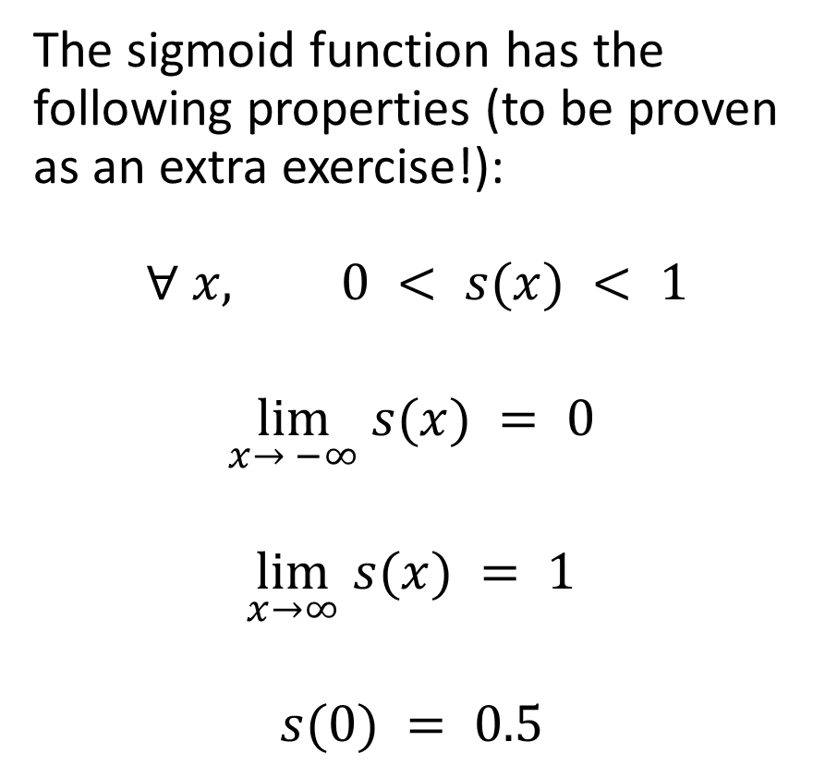
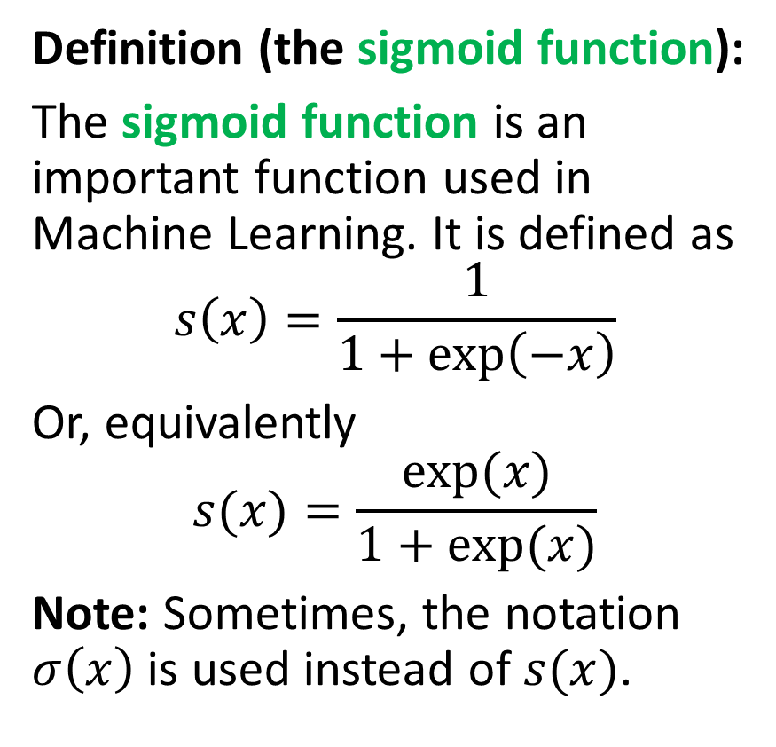
Introducing the sigmoid function
Definition (the sigmoid function):
The sigmoid function is an important function used in Machine Learning. It is defined as
$$s\left(x\right)=\frac{1}{1+\exp\left(−x\right)}$$
Or, equivalently
$$s(x)=\frac{exp⁡(x)}{1+exp⁡(x)}$$
Note: Sometimes, the notation $σ\left(x\right)$ is used instead of $s(x)$.
The sigmoid function has the following properties (to be proven as an extra exercise!):
$$∀ x, 0 < s(x) < 1$$
$$\lim_{x→ −∞} s(x) = 0$$
$$\lim_{x→∞} s(x) = 1$$
$$s(0) = 0.5$$

Slide 4
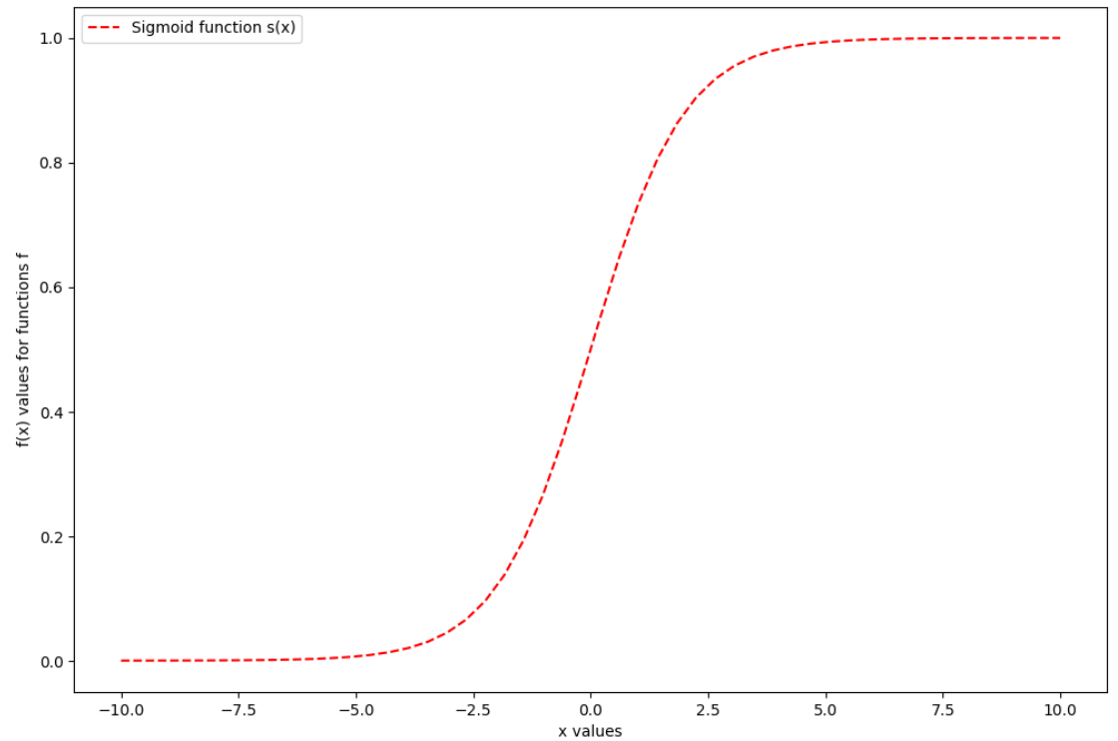


Introducing the sigmoid function
Definition (the sigmoid function):
The sigmoid function is an important function used in Machne Learning. It is defined as
$$s\left(x\right)=\frac{1}{1+\exp\left(−x\right)}$$
Or, equivalently
$$s(x)=\frac{exp⁡(x)}{1+exp⁡(x)}$$
The sigmoid function has the following properties:
$$∀ x, 0 < s(x) < 1$$
$$\lim_{x→ −∞} s(x) = 0$$
$$\lim_{x→∞} s(x) = 1$$
$$s(0) = 0.5$$

Slide 5
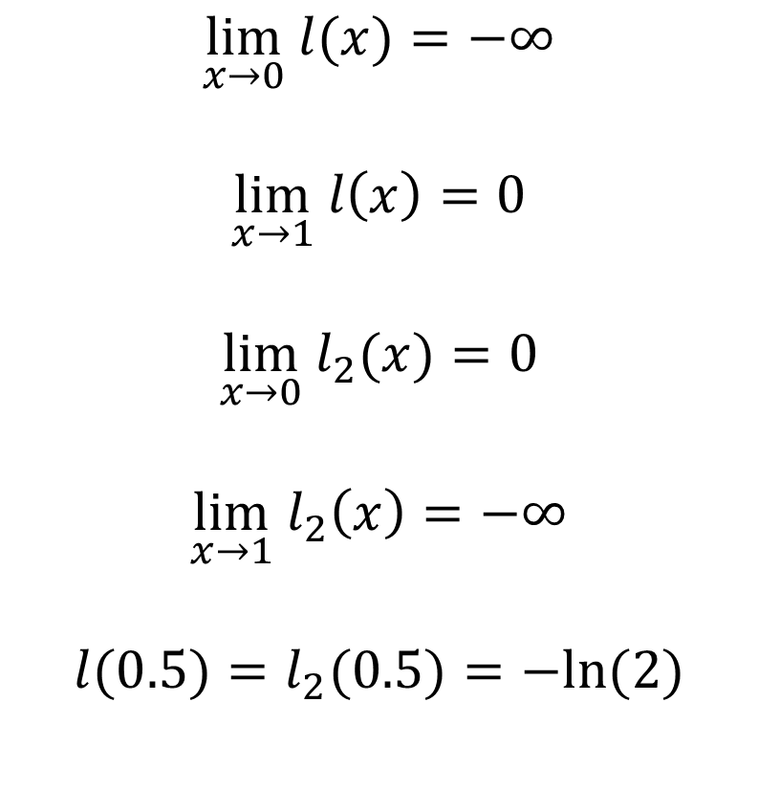
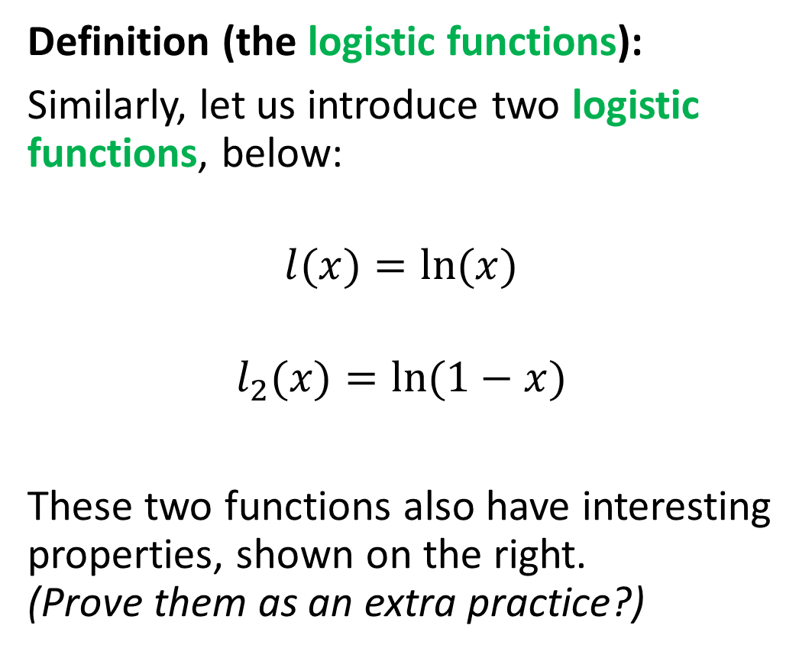
Also introducing two logistic functions
Definition (the logistic functions):
Similarly, let us introduce two logistic functions, below:
$$l(x)=ln⁡(x)$$
$$l_{2}(x)=ln⁡(1−x)$$
These two functions also have interesting properties, shown on the right.
(Prove them as an extra practice?)
$$\lim_{x→0} l(x)=−∞$$
$$\lim_{x→1} l\left(x\right)=0$$
$$\lim_{x→0} l_{2}(x)=0$$
$$\lim_{x→1}{ l}_{2}\left(x\right)=−∞$$
$$l(0.5)=l_{2}(0.5)=−ln⁡(2)$$

Slide 6
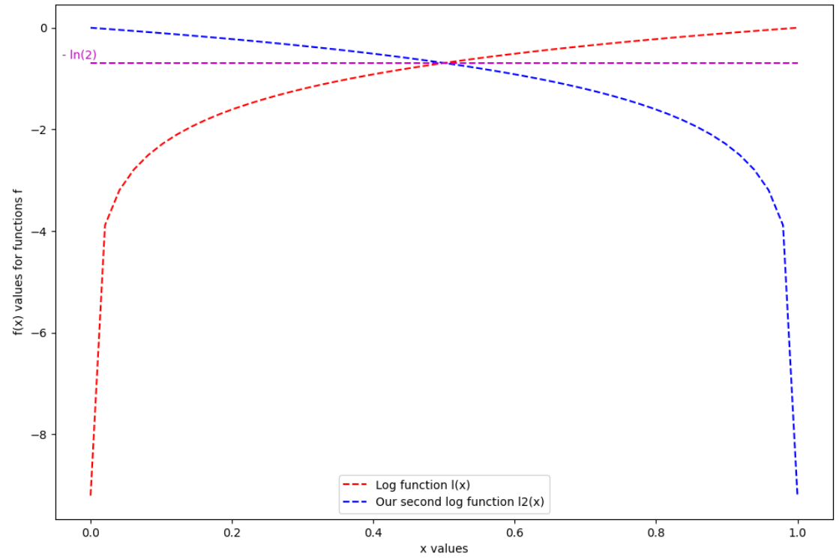


Introducing two logistic functions
Definition (the logistic functions):
Similarly, let us introduce two logistic functions, below:
$$l(x)=ln⁡(x)$$
$$l_{2}(x)=ln⁡(1−x)$$
These two functions also have interesting properties.
$$\lim_{x→0} l(x)=−∞$$
$$\lim_{x→1} l\left(x\right)=0$$
$$\lim_{x→0} l_{2}(x)=0$$
$$\lim_{x→1}{ l}_{2}\left(x\right)=−∞$$
$$l(0.5)=l_{2}(0.5)=−ln⁡(2)$$

Slide 7
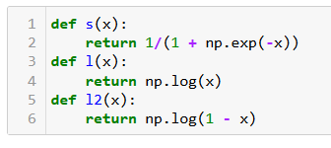
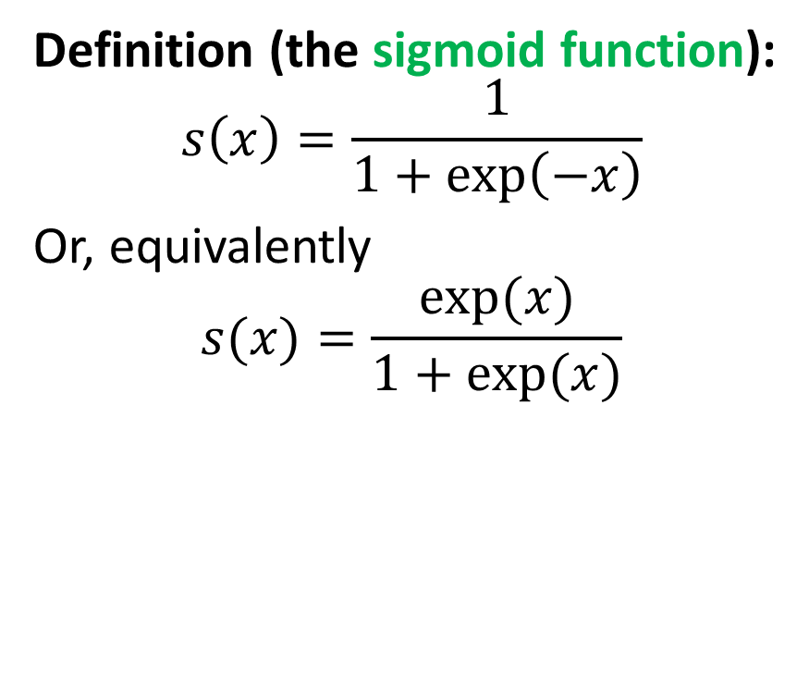
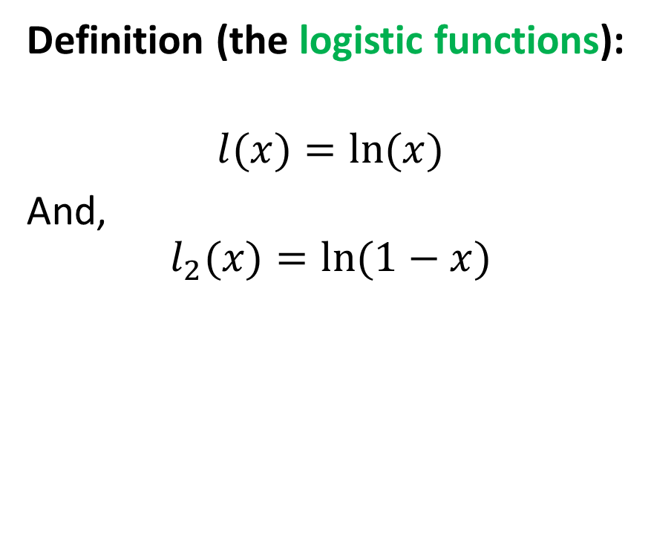
To recap: functions and implementations
Definition (the sigmoid function):
$$s\left(x\right)=\frac{1}{1+\exp\left(−x\right)}$$
Or, equivalently
$$s(x)=\frac{exp⁡(x)}{1+exp⁡(x)}$$
Definition (the logistic functions):
$$l(x)=ln⁡(x)$$
And,
$$l_{2}(x)=ln⁡(1−x)$$

Slide 8
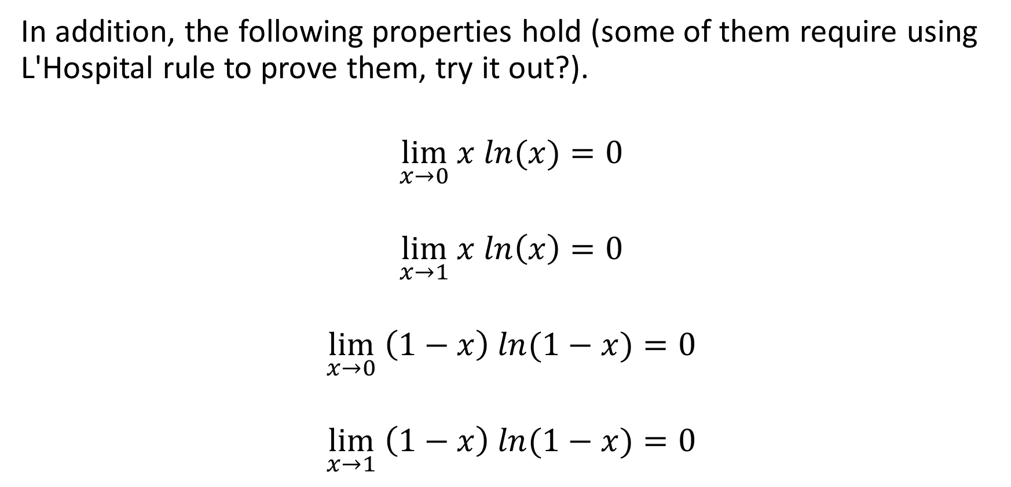
Results on mixes for our two logistic functions
In addition, the following properties hold (some of them require using L'Hospital rule to prove them, try it out?).
$$\lim_{x→0} x ln(x)=0$$
$$\lim_{x→1} x ln\left(x\right)=0$$
$$\lim_{x→0} \left(1−x\right) ln⁡(1−x)=0$$
$$\lim_{x→1} \left(1−x\right) ln⁡(1−x)=0$$

Slide 9
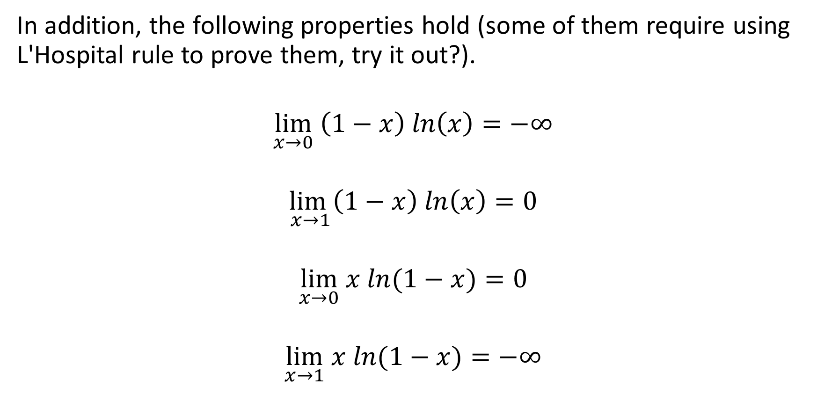
Results on mixes for our two logistic functions
In addition, the following properties hold (some of them require using L'Hospital rule to prove them, try it out?).
$$\lim_{x→0} \left(1−x\right) ln\left(x\right)=−∞$$
$$\lim_{x→1}\left(1−x\right) ln\left(x\right)=0$$
$$\lim_{x→0} x ln⁡(1−x)=0$$
$$\lim_{x→1} x ln⁡(1−x)=−∞$$

Slide 10
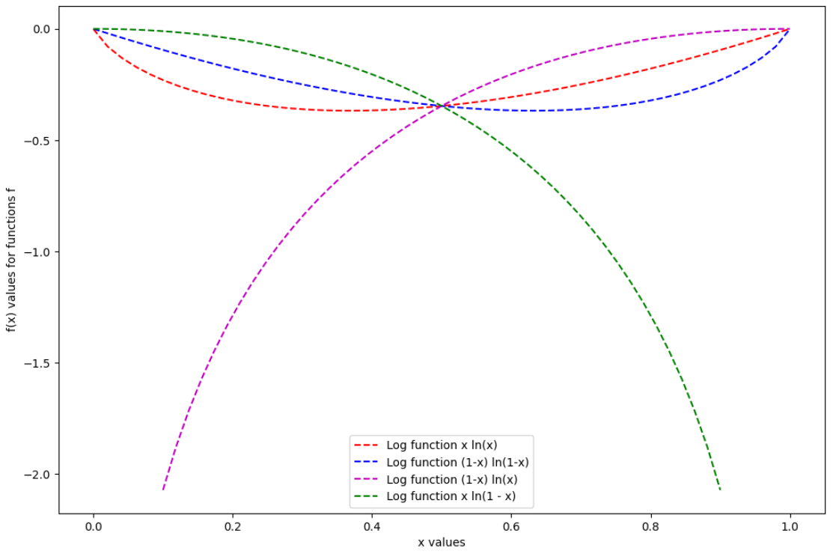

Introducing two logistic functions
In addition, the following properties hold (some of them require using L'Hospital rule to prove them).
$$\lim_{x→0} \left(1−x\right) ln\left(x\right)=−∞$$
$$\lim_{x→1}\left(1−x\right) ln\left(x\right)=0$$
$$\lim_{x→0} x ln⁡(1−x)=0$$
$$\lim_{x→1} x ln⁡(1−x)=−∞$$

Slide 11
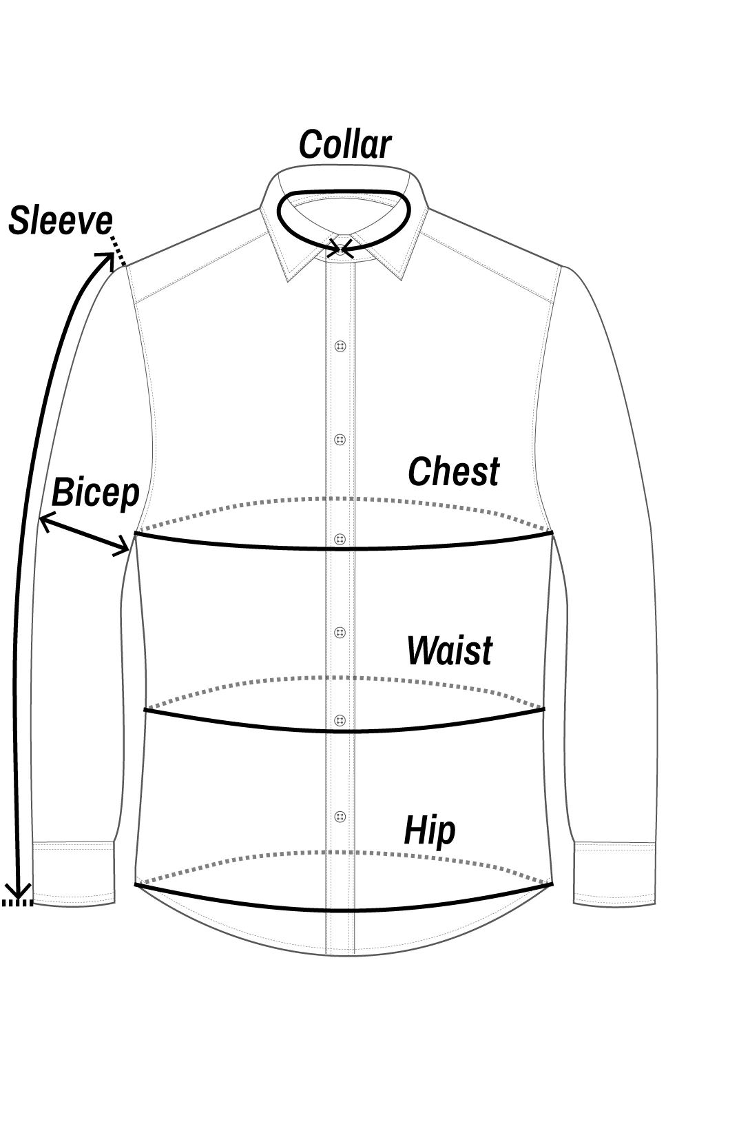
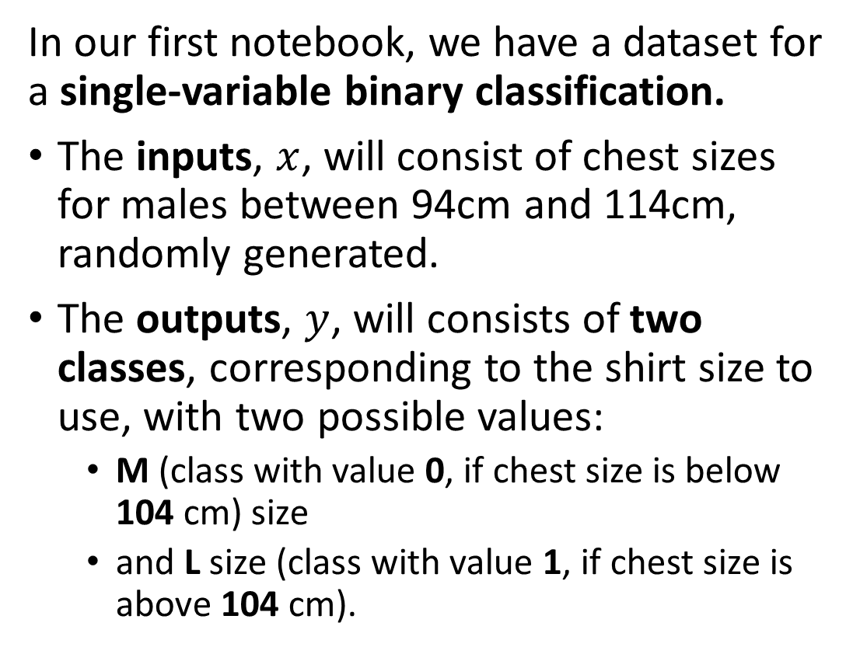
New mock dataset generation
In our first notebook, we have a dataset for a single-variable binary classification.
The inputs, $x$, will consist of chest sizes for males between 94cm and 114cm, randomly generated.
The outputs, $y$, will consists of two classes, corresponding to the shirt size to use, with two possible values:
  M (class with value 0, if chest size is below 104 cm) size
  and L size (class with value 1, if chest size is above 104 cm).

Slide 12
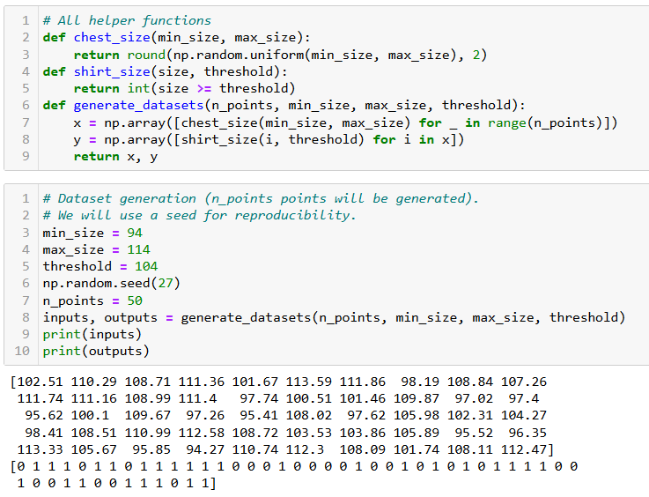

Slide 13
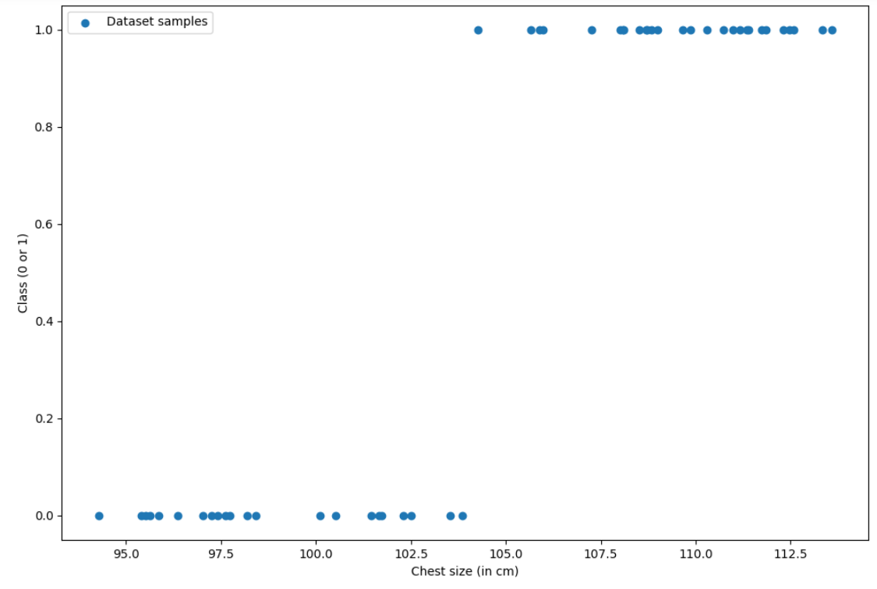

Slide 14
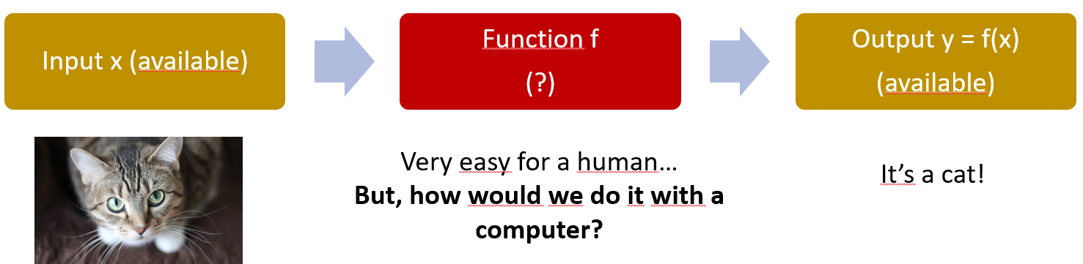
A quick word about expert systems
Definition (expert systems):
An expert system is a computer program that mimics the decision-making abilities of a human expert in a specific domain or field.
It uses knowledge represented in a symbolic form, such as rules or ontologies, to make inferences and decisions based on the data it receives.
Expert systems are “the dream” and provide a high level of performance and accuracy in solving problems or making decisions. But these are difficult to design as they require a strong, and not necessarily obvious, human expertise.

Slide 15
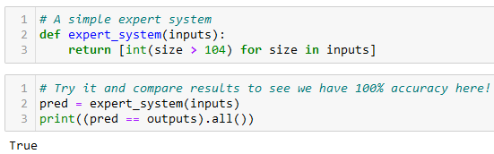
A quick word about expert systems
Definition (expert systems):
An expert system is a computer program that mimics the decision-making abilities of a human expert in a specific domain or field.
It uses knowledge represented in a symbolic form, such as rules or ontologies, to make inferences and decisions based on the data it receives.
Important note: in our case, we could define an expert system as shown below, but most of the time the datasets will not have a clear logic and you will have to rely on ML algorithms instead, basically “hoping the AI will figure out a logic that works”.

Slide 16
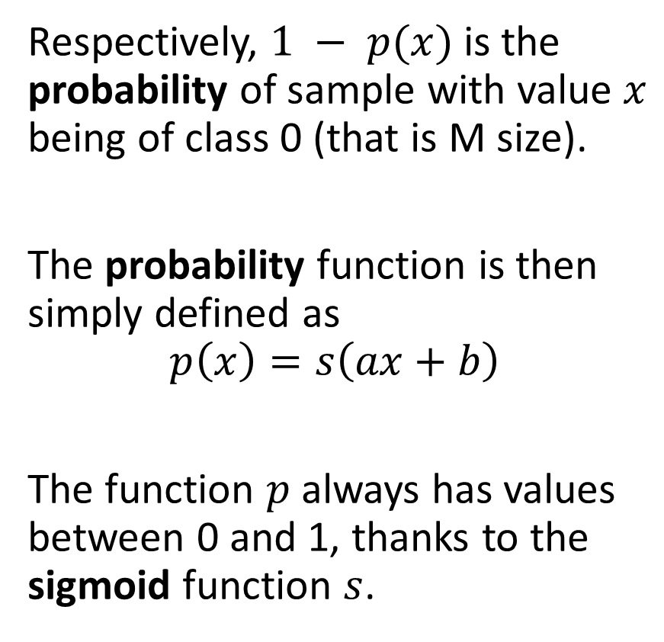
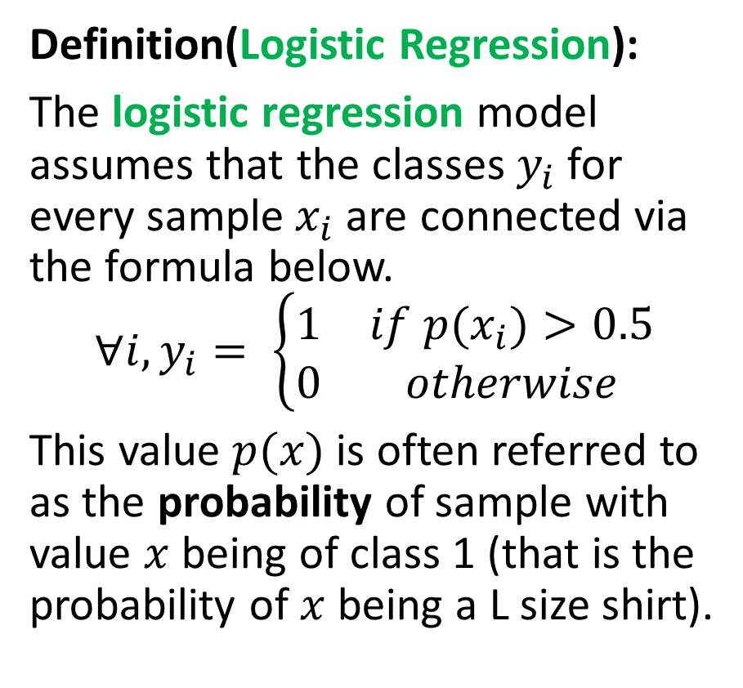
From Linear Regression to Logistic Regression
Definition(Logistic Regression):
The logistic regression model assumes that the classes $y_{i}$ for every sample$x_{i}$are connected via the formula below.
$$∀i, y_{i}= \left\{\begin{matrix}1 & if p(x_{i})>0.5 \\ 0 & otherwise\end{matrix}\right.$$
This value $p(x)$is often referred to as the probability of sample with value $x$ being of class 1 (that is the probability of $x$ being a L size shirt).
Respectively, $1 − p(x)$is the probability of sample with value $x$ being of class 0 (that is M size).
The probability function is then simply defined as
$$p\left(x\right)=s\left(ax+b\right)$$
The function $p$always has values between 0 and 1, thanks to the sigmoid function $s$.

Slide 17
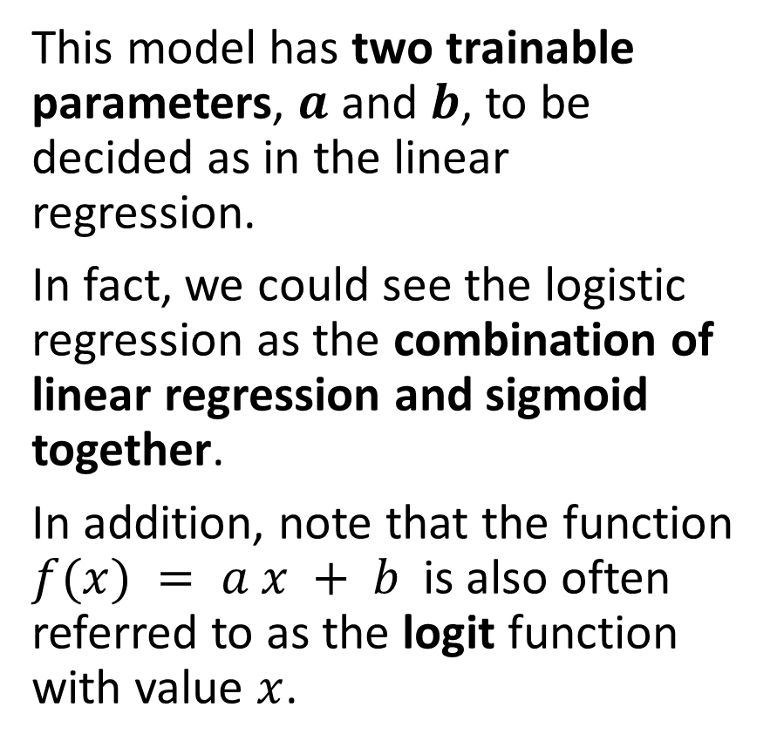
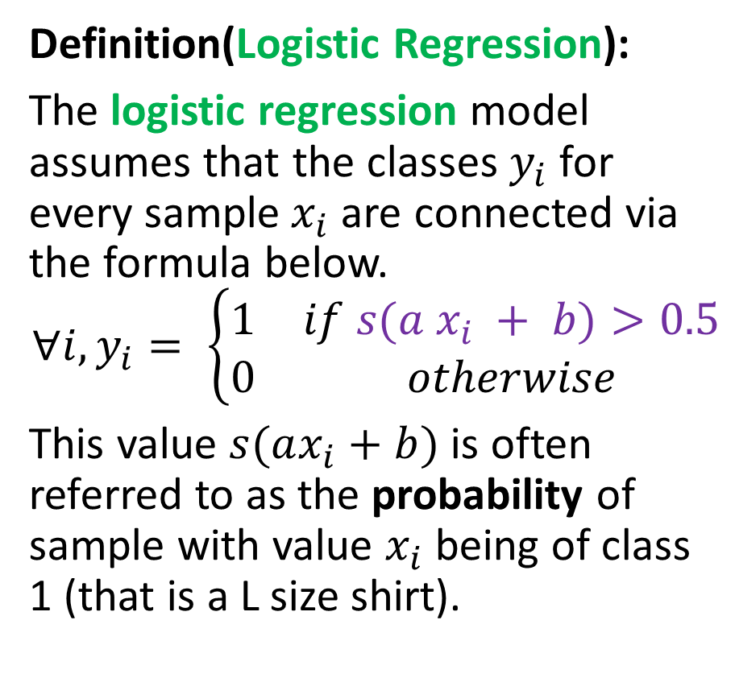
An adjusted Logistic Regression
Definition(Logistic Regression):
The logistic regression model assumes that the classes $y_{i}$ for every sample$x_{i}$are connected via the formula below.
$$∀i, y_{i}= \left\{\begin{matrix}1 & if s(a x_{i} + b)>0.5 \\ 0 & otherwise\end{matrix}\right.$$
This value $s(ax_{i}+b)$is often referred to as the probability of sample with value $x_{i}$ being of class 1 (that is a L size shirt).
This model has two trainable parameters, $a$ and $b$, to be decided as in the linear regression.
In fact, we could see the logistic regression as the combination of linear regression and sigmoid together.
In addition, note that the function $f(x) = a x + b$is also often referred to as the logit function with value $x$.

Slide 18
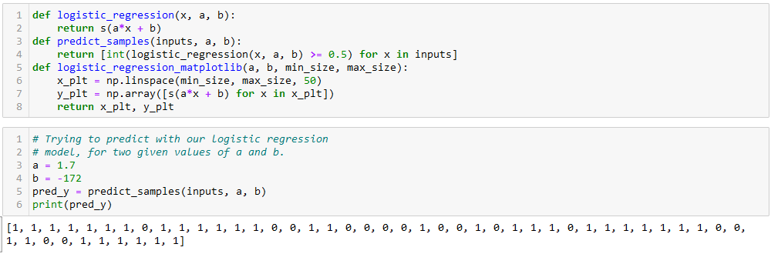

From Linear Regression to Logistic Regression
We can implement the logistic regression below and try it out with some values $a$ and $b$!

Slide 19
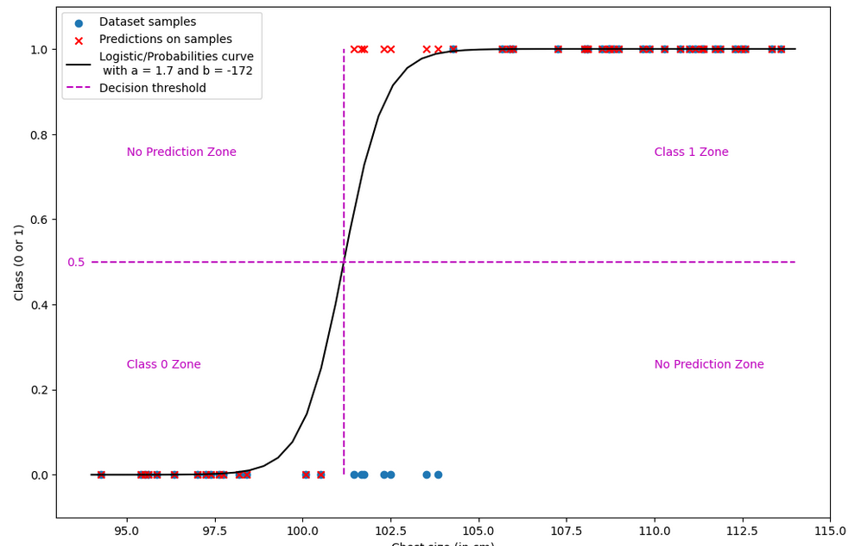

Slide 20
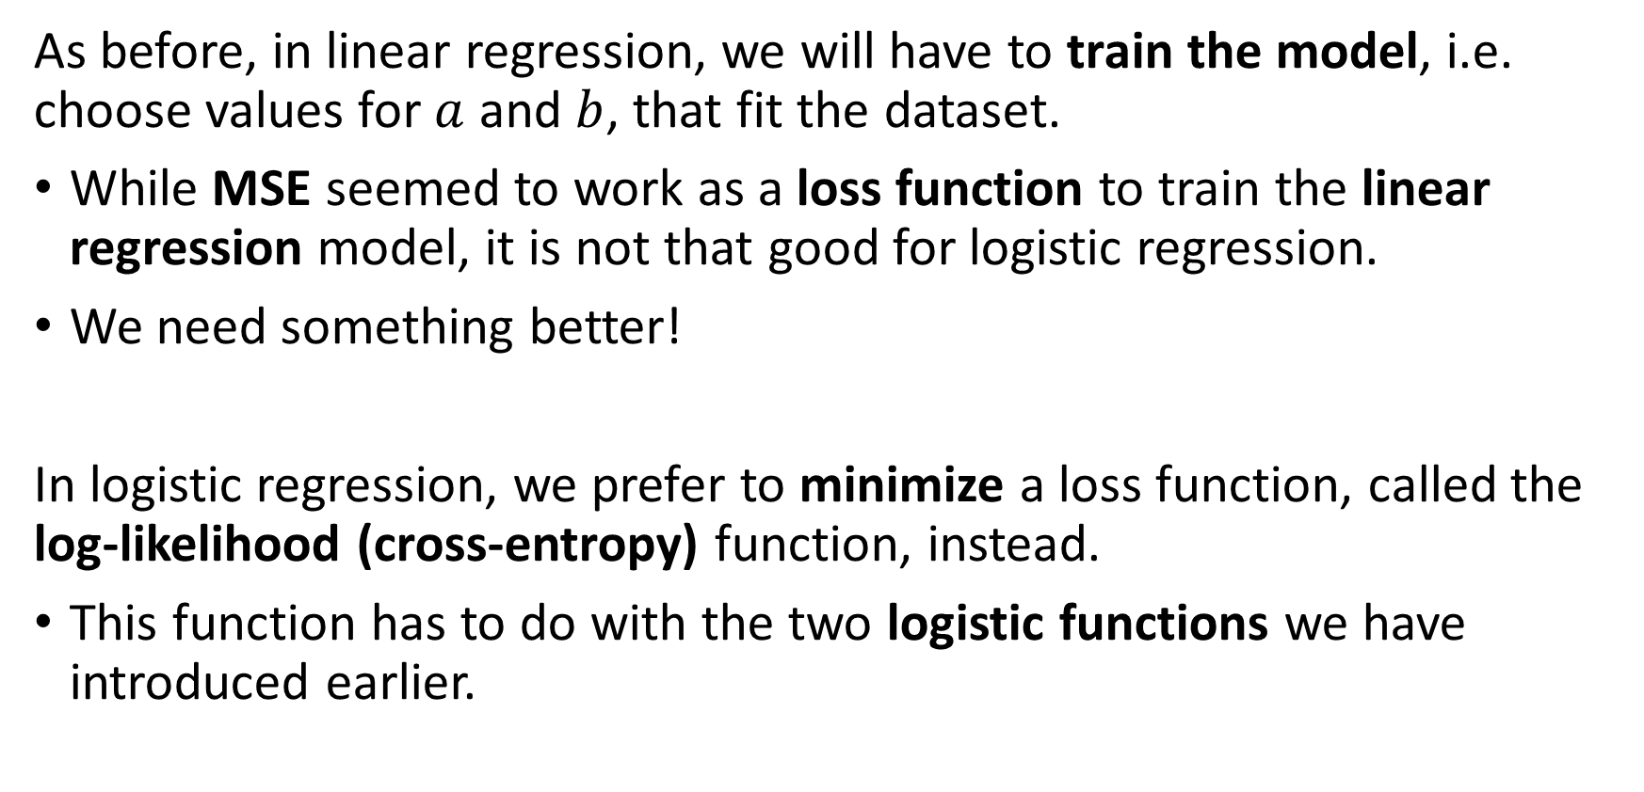
Training a logistic regressor
As before, in linear regression, we will have to train the model, i.e. choose values for $a$ and $b$, that fit the dataset.
While MSE seemed to work as a loss function to train the linear regression model, it is not that good for logistic regression.
We need something better!
In logistic regression, we prefer to minimize a loss function, called the
log-likelihood (cross-entropy) function, instead.
This function has to do with the two logistic functions we have introduced earlier.

Slide 21
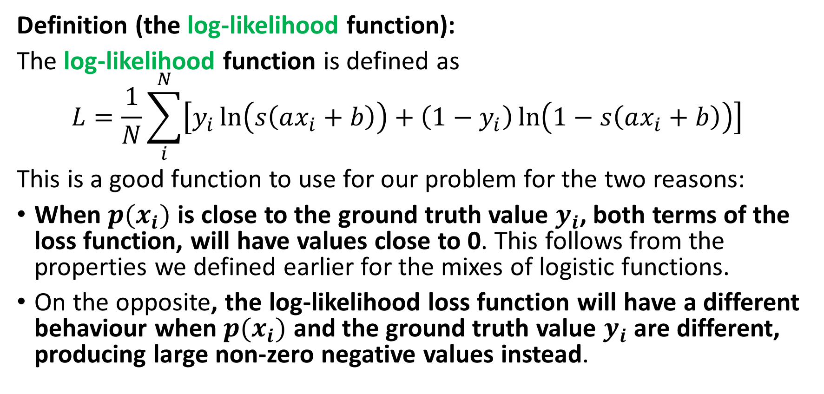
The log-likelihood function and loss
Definition (the log-likelihood function):
The log-likelihood function is defined as
$$L=\frac{1}{N}\sum_{i}^{N}{\left[y_{i}\ln\left(s\left(ax_{i}+b\right)\right)+\left(1−y_{i}\right)\ln\left(1−s\left(ax_{i}+b\right)\right)\right] }$$
This is a good function to use for our problem for the two reasons:
When $p(x_{i})$ is close to the ground truth value $y_{i}$, both terms of the loss function, will have values close to 0. This follows from the properties we defined earlier for the mixes of logistic functions.
On the opposite, the log-likelihood loss function will have a different behaviour when $p(x_{i})$ and the ground truth value $y_{i}$ are different, producing large non-zero negative values instead.

Slide 22
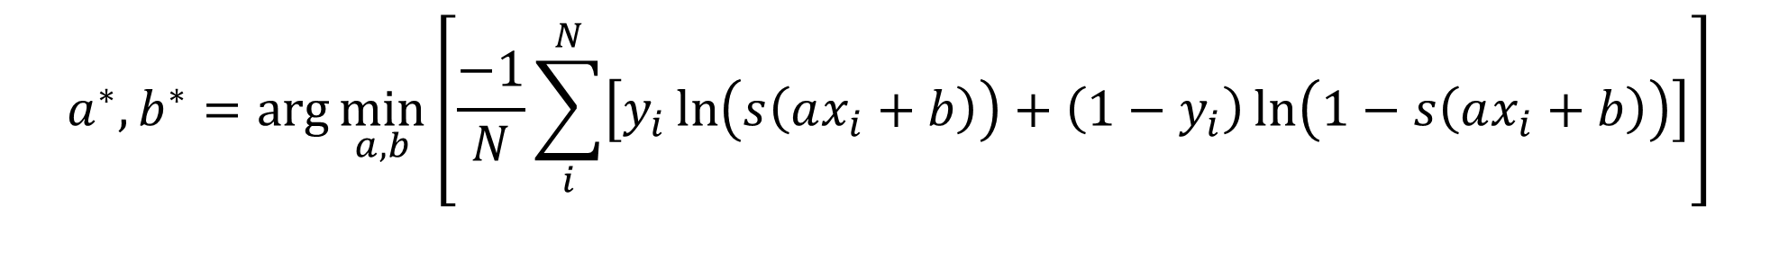
The log-likelihood function and loss
Definition (using the log-likelihood function as a loss):
This log-likelihood loss function is therefore a good choice of a performance/loss metric to measure the performance of our models.
Indeed, maximizing this log-likelihood loss function and bringing it to zero would be equivalent to finding the best choice of parameters 𝑎 and 𝑏, and therefore the best fit.
In practice however, we prefer to minimize loss functions. This requires a simple adjustment, multiplying the log-likelihood loss function by -1.
$$a^{∗},b^{∗}=\arg{\min_{a,b}\left[\frac{−1}{N}\sum_{i}^{N}{\left[y_{i}\ln\left(s\left(ax_{i}+b\right)\right)+\left(1−y_{i}\right)\ln\left(1−s\left(ax_{i}+b\right)\right)\right]}\right]}$$

Slide 23

Implementing the log-likelihood loss
We can simply implement the log likelihood loss as shown below.
Note: We could look for the ”normal equation” for the logistic regression, but this simply will not work. It is simply impossible to solve the logistic regression problem analytically.
(Not convinced? Try solving it analytically!).

Slide 24
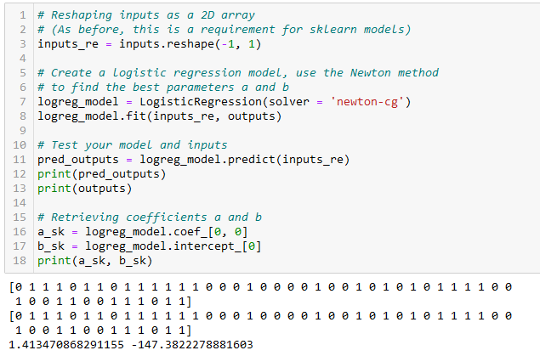
Training a logistic regressor
Instead, it is often preferable to rely on the gradient descent method, or the Newton method.
Typically, this is what the LogisticRegression() object in sklearn uses for training!
(Newton method is not covered but feel free to look it up/try it out?)

Slide 25
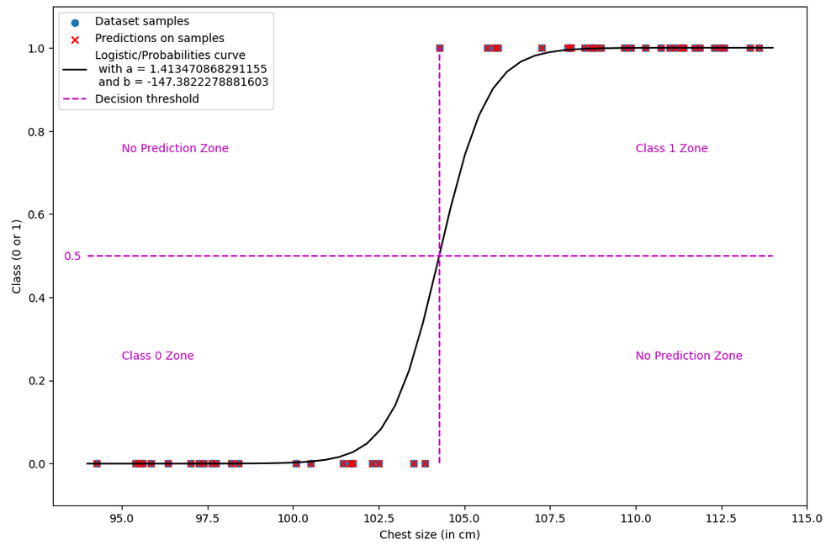

Slide 26
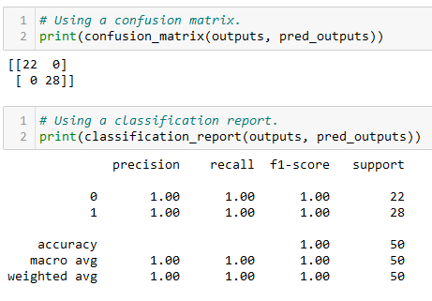
Evaluating the logistic regression model
When attempting to evaluate a classification model, it is often a good idea to first display a confusion matrix for the predicted values of the dataset samples (test samples, preferably).
We can simply calculate it by using the confusion_matrix() function from sklearn. The non-diagonal elements have zero values, which is the sign that our model classifies perfectly.
Learn more, here: https://scikit-learn.org/stable/modules/generated/sklearn.metrics.confusion_matrix.html.

Slide 27
Evaluating the logistic regression model
We can also ask for a classification report for the trained model.
This shows the precision, recall and F1 scores for each class, as well as the overall accuracy of the model.
For each one of these interesting metrics, the best value is 1.0. Our model achieves a 1.0 score, suggesting that the model classifies perfectly.
Learn more, here: https://scikit-learn.org/stable/modules/generated/sklearn.metrics.classification_report.html#sklearn.metrics.classification_report.
Note: the details of these metrics and what they represented is not discussed here (covered in previous ML classes).

Slide 28
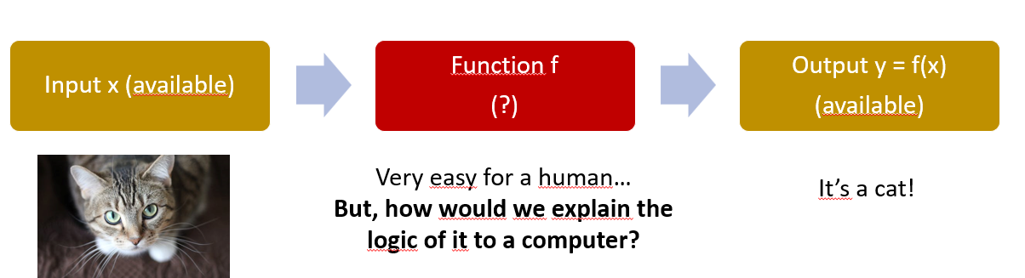
A bit of biology
Many tasks we have seen earlier (e.g. appt prices) are “difficult” to solve, or do not have an obvious “explainable” logic.
Our brain, however, seems very capable to solve these tasks.
Million dollar question: Could we replace the linear/polynomial/logistic models with a model that mimics the brain?

Slide 29
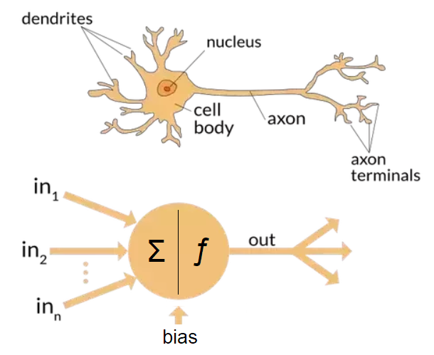
A bit of biology
Question: In neural networks, we will implement neurons, but are they really close to the ones in the human brain?
Neural networks are inspired by the neural structure and processes of the human brain.
Neural networks are comprised of interconnected nodes, which are called artificial neurons or perceptrons.
Neural networks are related to biology in that they are modelled after biological neural systems.

Slide 30
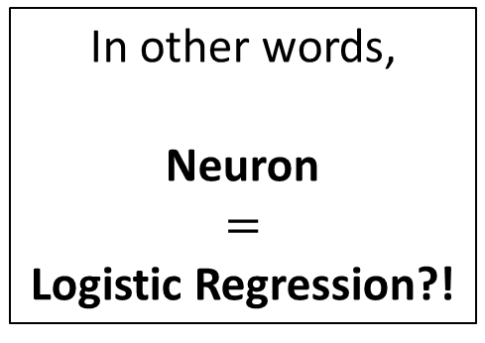
A bit of biology
In general,
A neuron will receive stimuli through its dendrites, in the form of electrical signals playing the role of inputs,
It will process the inputs in a certain way in its nucleus (and other parts of the neuron),
If the integrated signals reach a threshold, the neuron generates an action potential, a brief electrical impulse. This is an output coming from the axon terminal, in the form of a signal (1) or no signal (0) being produced.
In other words,
Neuron
$$=$$
Logistic Regression?!

Slide 31
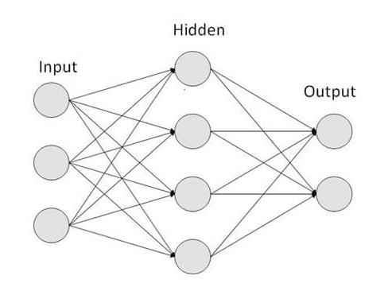
A bit of biology
Eventually the output signal produced by a neuron will be passed to other neurons in the brain.
The brain could be seen as a set of several neurons processing information, both in parallel and in sequence.
This assembly, which resembles the human brain, is commonly referred to as a neural network.

Slide 32
A bit of biology
Research has shown that artificial neural networks could indeed be used to solve some of the problems that biological neural networks can solve.
For example, neural networks can be used to identify objects in images, just as biological neural networks can.
The training process of CS neural networks is apparently very similar to the biological neural networks.
This is actually an ongoing argument: see [Quanta2021] and [MITNews2022].

Slide 33
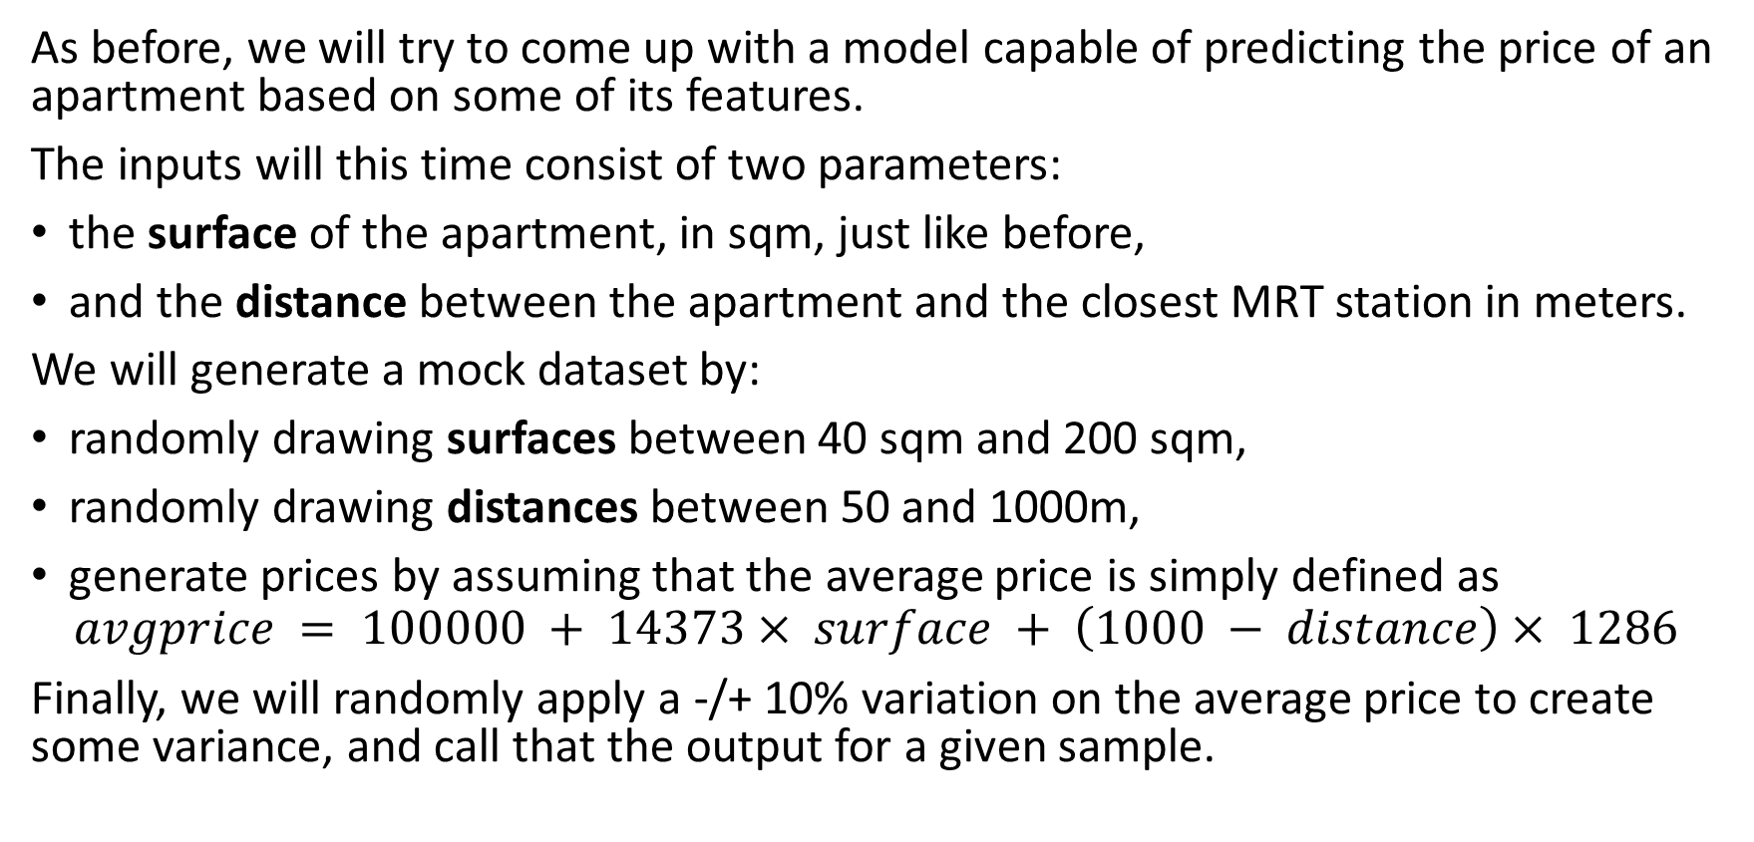
Starting with a mock dataset, again
As before, we will try to come up with a model capable of predicting the price of an apartment based on some of its features.
The inputs will this time consist of two parameters:
the surface of the apartment, in sqm, just like before,
and the distance between the apartment and the closest MRT station in meters.
We will generate a mock dataset by:
randomly drawing surfaces between 40 sqm and 200 sqm,
randomly drawing distances between 50 and 1000m,
generate prices by assuming that the average price is simply defined as
$$avgprice = 100000 + 14373× surface + \left(1000 − distance\right)× 1286$$
Finally, we will randomly apply a -/+ 10% variation on the average price to create some variance, and call that the output for a given sample.

Slide 34
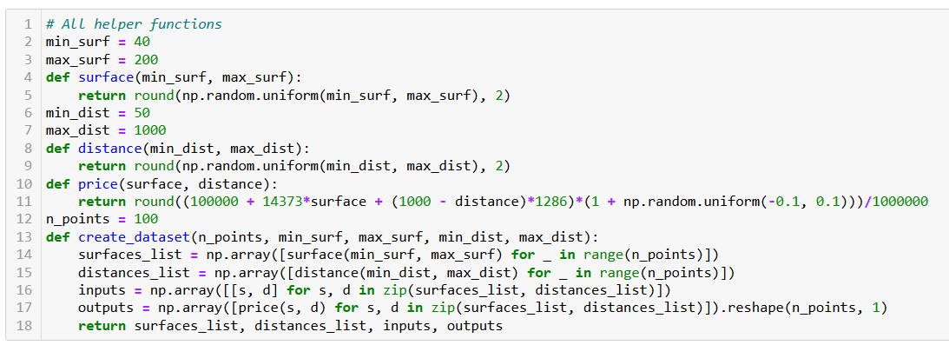
Starting with a mock dataset, again

Slide 35
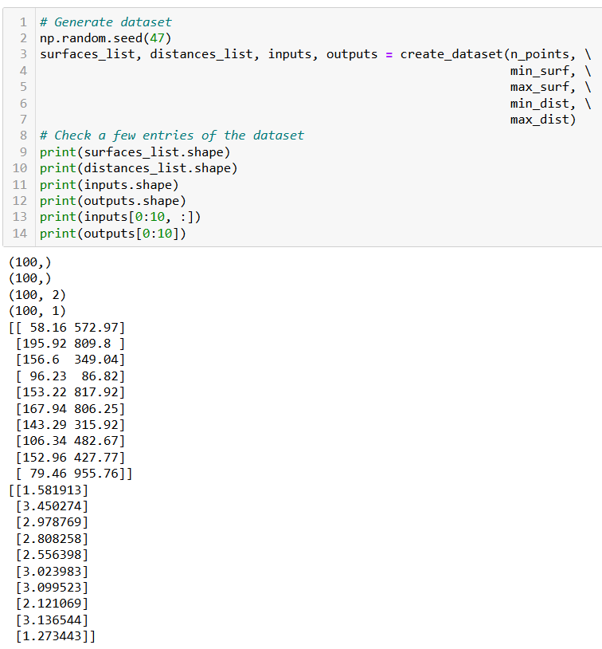

Slide 36
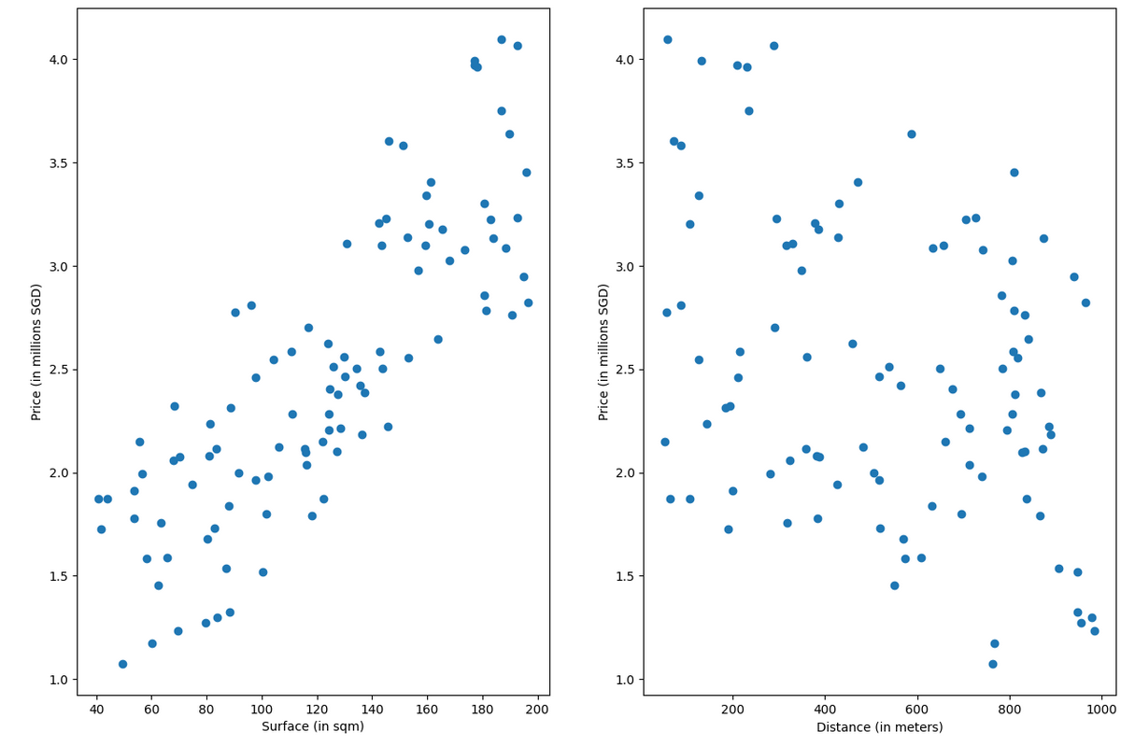

Slide 37
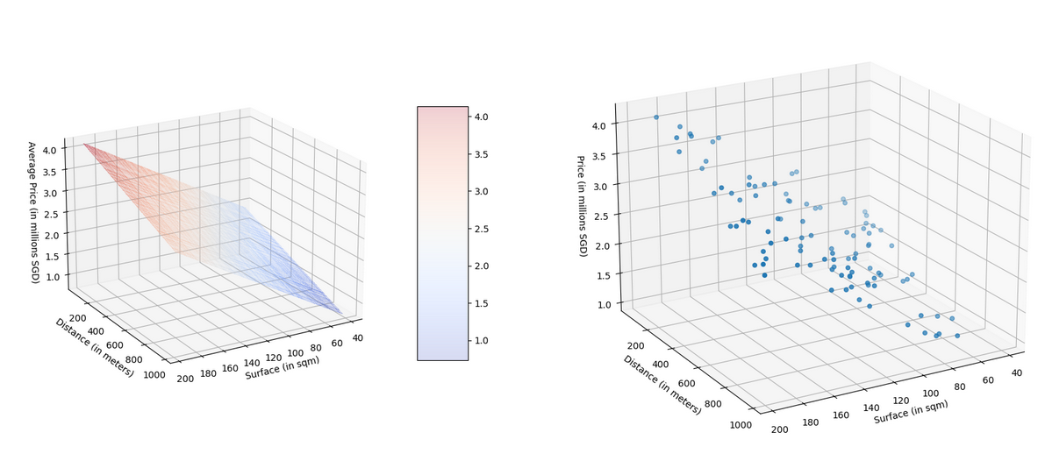
$$avgprice = 100000 + 14373× surface + \left(1000 − distance\right)× 1286$$
is actually the equation of a 2D plane in a 3D ambient space!

Slide 38
Coding a Neuron and a Neural Network
Definition (Neuron in Neural Networks):
Each artificial neuron in a neural network might for instance be represented as a linear regression (or later on, a logistic regression) model, which receives input, applies a transformation on that input, and produces an output.
And similar to the way that biological neurons are connected and communicate with each other, artificial neurons are connected to each other, in parallel and in sequence, through a network. This neural network can be thought of as pathways for information to flow.
(Later on, we will see more advanced ways to represent neurons than linear or logistic regression.)

Slide 39
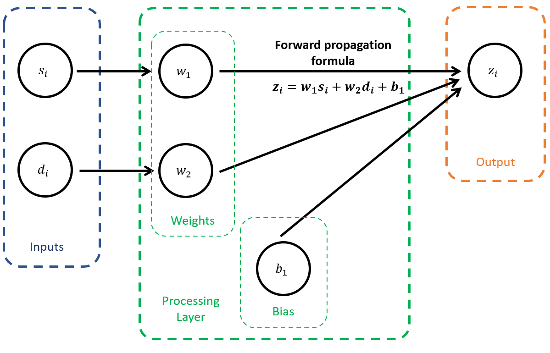
Coding our first Neuron

Slide 40
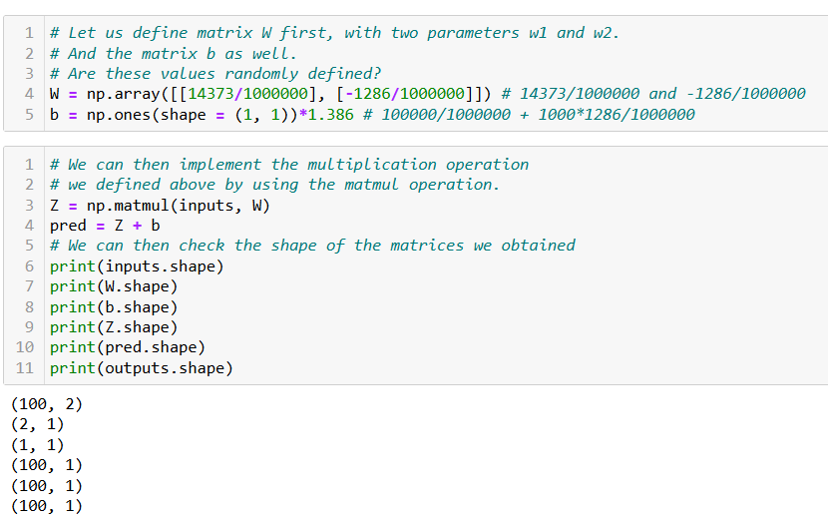

Slide 41
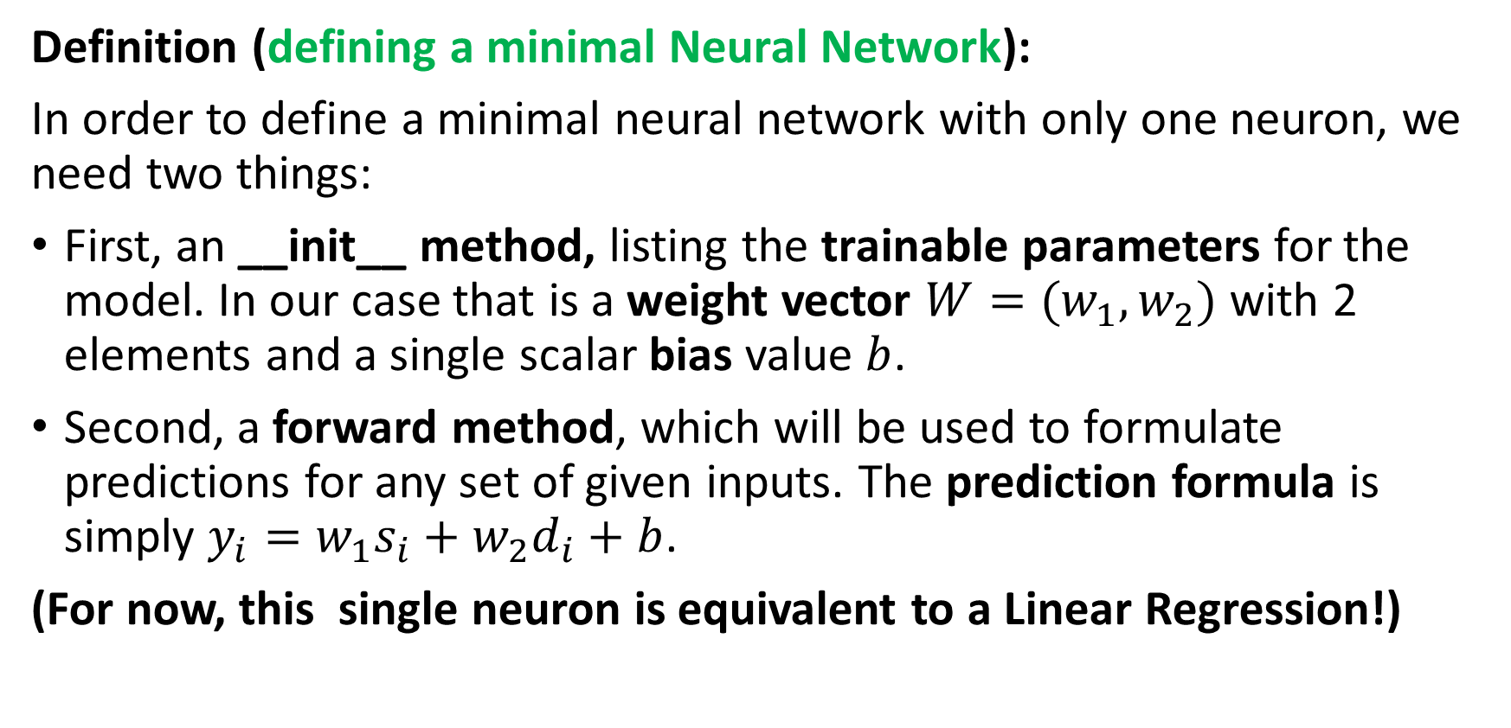
Defining a minimal Neural Network
Definition (defining a minimal Neural Network):
In order to define a minimal neural network with only one neuron, we need two things:
First, an __init__ method, listing the trainable parameters for the model. In our case that is a weight vector $W=(w_{1}, w_{2})$ with 2 elements and a single scalar bias value $b$.
Second, a forward method, which will be used to formulate predictions for any set of given inputs. The prediction formula is simply $y_{i}=w_{1}s_{i}+w_{2}d_{i}+b$.
(For now, this single neuron is equivalent to a Linear Regression!)

Slide 42
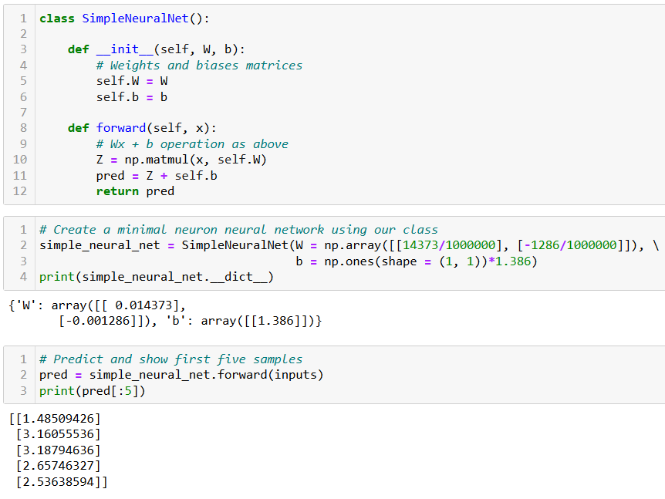

Slide 43
Adding a loss
This takes care of the first three elements of a machine learning problem (task, dataset, model).
The fourth element we need to define is a loss function.
As this is a regression task, we can reuse the MSE loss and add this MSE loss function as a method to our class.
For convenience, we will compute the MSE loss in in matrix form.
We will also reuse the forward() method we just coded to make predictions and then compared said predictions with the expected outputs from our dataset.

Slide 44
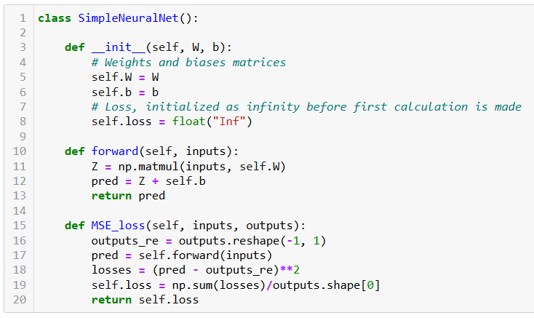
Adding a loss

Slide 45


Scaling up with more parameters
Technically, our Neural Network could operate with any number of inputs $N_{x}$ and any number of outputs $N_{y}$.
We would simply need to adjust the sizes of the matrices of parameters:
$W$ as a $N_{x}×N_{y}$ matrix,
B as a $N_{y}$ vector.
Note: This would be equivalent to having $N_{y}$neurons, each receiving $N_{x}$inputs, and each producing one output to be assembled as the $Z$ vector.

Slide 46

Scaling up with more layers
Definition (Shallow Neural Network):
Following the logic of our SimpleNeuralNet, we could implement a Shallow Neural Network. It will include two processing layers of neurons in a row, instead of just one, and each layer will be implementing its own $WX + b$operation of some sort.

Slide 47

Scaling up with more layers

Slide 48

Scaling up with more layers
The first layer, will receive inputs with dimensionality $n_{x}$and produce outputs with dimensionality $n_{h}$.
The matrix $W$ for this first layer will therefore be of size $n_{x}× n_{h}$, and the matrix $b$ will be a simple 1D vector with size $n_{h}$.

Slide 49

Scaling up with more layers
The second layer, also called hidden layer, will receive the outputs from the previous layer with dimensionality$n_{h}$, use them as inputs and will produce outputs matching the dimensionality of the outputs in our dataset, $n_{y}$.
The matrix $W$ for this second layer will be 2D $n_{h}× n_{y}$, and $b$ will be 1D $n_{y}$.

Slide 50


Our NN class
Small changes:
Weights and biases
are now randomly initialized, instead of being passed to the init method.
We pass the expected sizes $n_{x}, n_{h}, n_{y}$ instead.
And initialize parameters matrices as normal random with zero mean and variance 0.1.

Slide 51



Initialize model
Forward to predict
Compute loss to evaluate model
(it is bad, because trainable parameters have completely random values at the moment!)

Slide 52

The need for a training procedure
At the moment, we have coded a model that can initialize trainable parameters randomly, formulate predictions and evaluate its own performance.
It is great, but we have no way to adjust the weights manually.
We can only try a few different initialization and pray the RNG gods to give us trainable parameters with a good loss.
We need a training
procedure!
What could it be…?

Slide 53
Let us call it a break for now
We will continue on the next lecture with the training procedure for this Neural Network we just built.

